Slide 1
Government of the People’s Republic of Bangladesh
Ministry of Housing and Public Works
Urban Development Directorate (UDD)
“Preparation of Development Plan
for Fourteen Upazilas”
Package-04 (Saghata Upazila, District: Gaibandha; Sariakandi and Sonatala Upazila, District: Bogra)
CONSULTANT:
Modern Engineers, Planners & Consultants Ltd.

Slide 2
Welcome To The Presentation On
Progress of Work: Saghata, Sariakandi & Sonatala
Upazila (Package-04)
16 May, 2017
Presented by: Dr. Shamim Mahabubul Haque
Team Leader, Package- 04
Preparation of Development Plan for Fourteen Upazilas

Slide 3
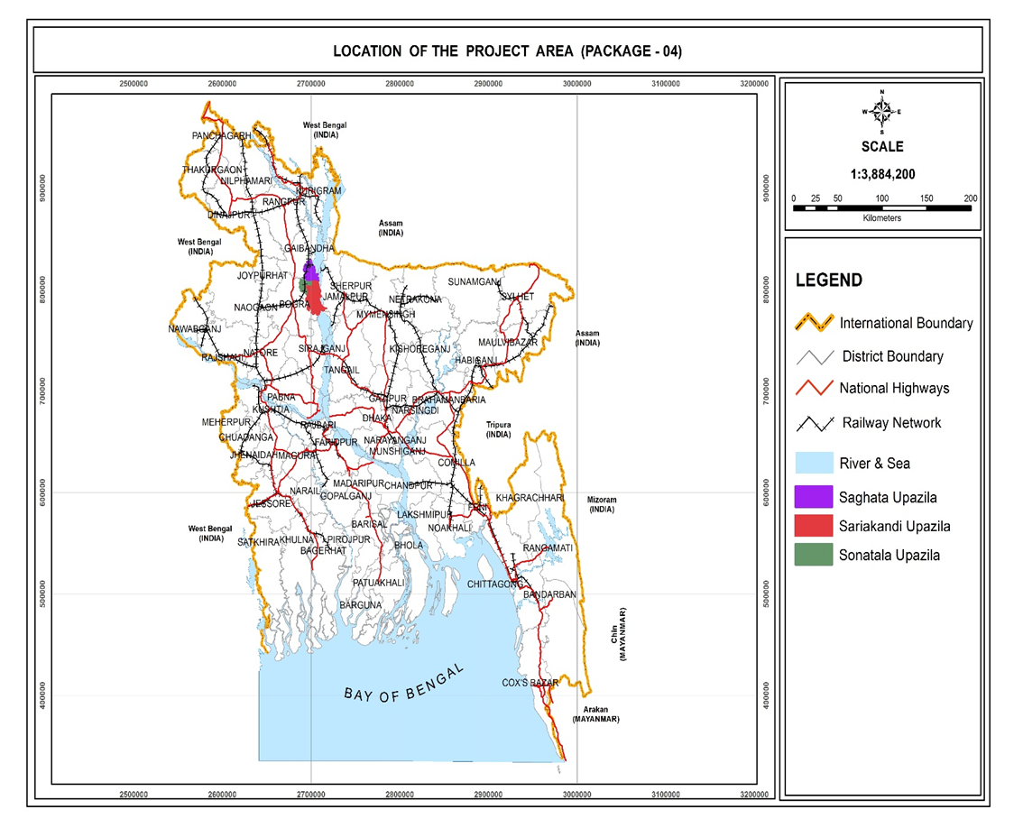
Location Map of the Project Area: Package-4
Package-04
Project Area
Saghata Upazila of
Gaibandha District
And
Sariakandi & Sonatala Upazila of Bogra
District

Slide 4
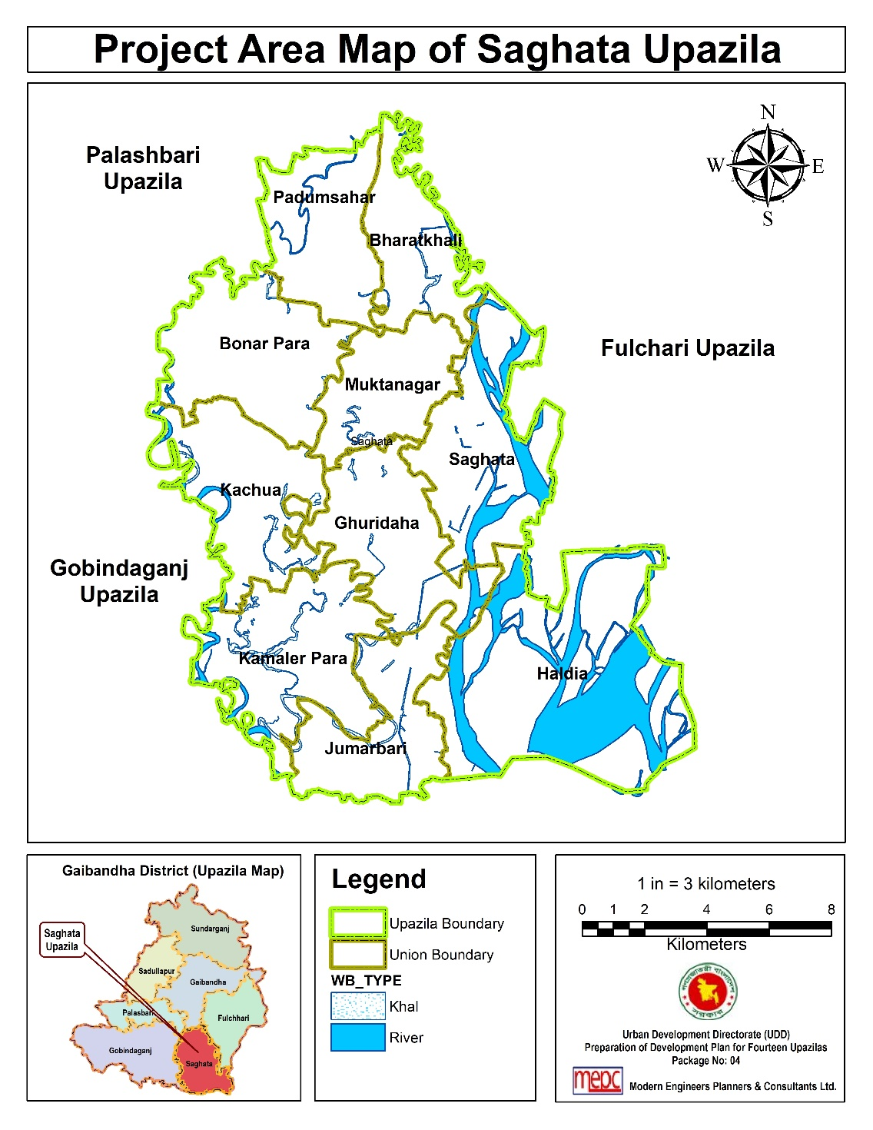
At a Glance of Saghata Upazila
Name of Upazila: Saghata
Name of District: Gaibandha
Administrative Unit: 10 Unions, 116 Mauzas and 130 Villages.
Planning Area: 231.02 sq. km.
Total Population: 2,67,819
Urban Population: 15,883
Rural Population: 2,51,936
Population Density: 1159 (per sq. km.)
(Source: BBS, 2011)

Slide 5
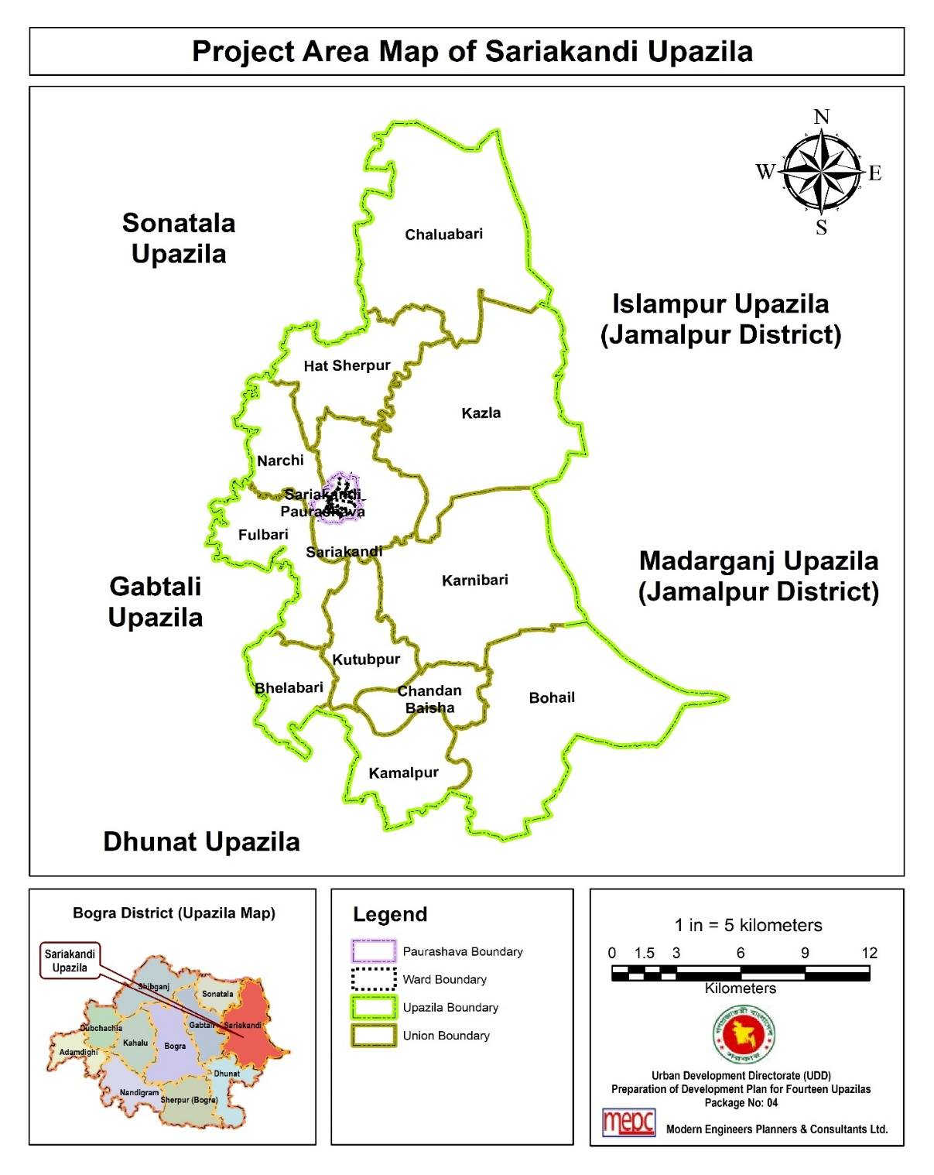
At a Glance of Sariakandi Upazila
Name of Upazila: Sariakandi
Name of District: Bogra
Administrative Unit: 1 Paurashava, 12 Unions, 117 Mauzas and 173 Villages.
Planning Area: 408.50 sq. km.
Total Population: 2,70,719
Urban Population: 18,543
Rural Population: 2,52,176
Population Density: 663 (per sq. km.)
(Source: BBS, 2011)

Slide 6
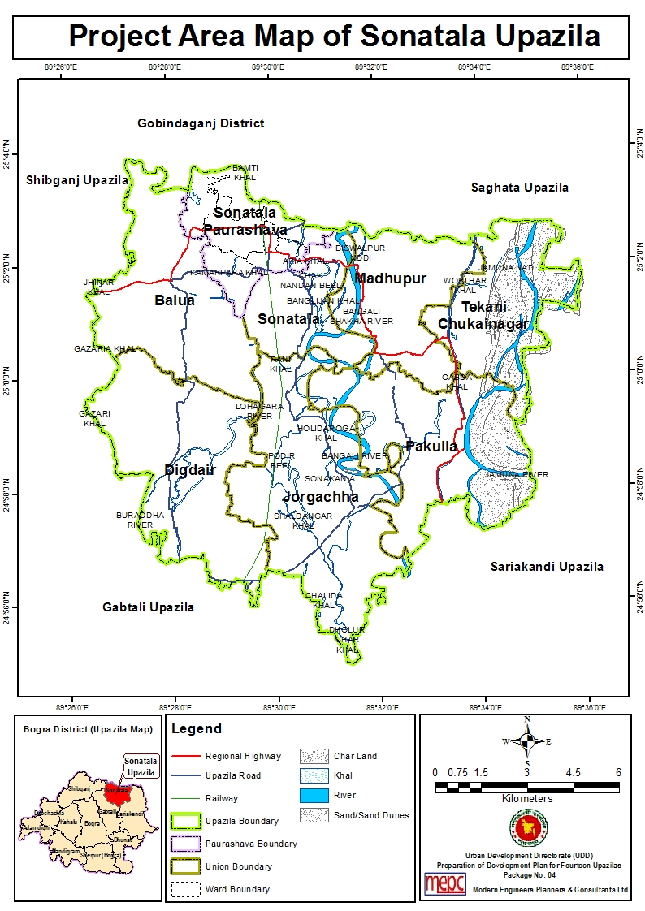
At a Glance of Sonatala Upazila
Name of Upazila: Sonatala
Name of District: Bogra
Administrative Unit: 1 Paurashava, 7 Unions, 94 Mauzas and 125 Villages.
Planning Area: 156.73 sq. km.
Total Population: 1,86,778
Urban Population: 24,720
Rural Population: 1,62,058
Population Density: 1191 (per sq. km.)
(Source: BBS, 2011)

Slide 7
Submission of Plan & Report
Major Deliverables | Status of Deliverable | TMC Meeting
Mobilization Report | Submitted | 21.01.2015
Inception Report | Submitted | 26.05.2015
Draft Survey Report | Submitted | 04.06.2017
Final Survey Report | Submitted | 16.06.2017
Draft Final Plan with Report | On Going | -
Final Plan with Report | - | -

Slide 8
Status of Field Surveys
Name of Survey/Activities | Upazila Wise Status
 | Saghata | Sariakandi | Sonatala
Mauza Map Collection | Done | Done | Done
Mauza Map Scanning & Digitization | Done | Done | Done
Collection of Satellite Image | Done | Done | Done
Satellite Image Processing | Done | Done | Done
BM Pillar Installation and GCP Collection | Done | Done | Done
Physical Feature Survey | Done | Done | Done
Land use Survey | Done | Done | Done
Topographical Survey | Done | Done | Done
Photogrammetric Work | Done | Done | Done
Participatory Rural Appraisal (PRA) | Done | Done | Done
Socio-economic Survey | Done | Done | Done
Formal-Informal Economic Survey | Done | Done | Done
Geological and Geo-physical Survey | Done | Done | Done
Hydrological Survey | Done | Done | Done
Agricultural Survey | Done | Done | Done
Traffic and Transportation Survey | Done | Done | Done
Building Vulnerability Assessment | Done | Done | Done
Ground Truthing by RTK-GPS | Done | Done | Done

Slide 9
Activities Performed so far…

Slide 10
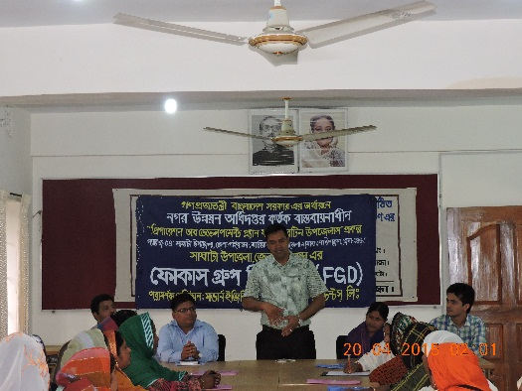
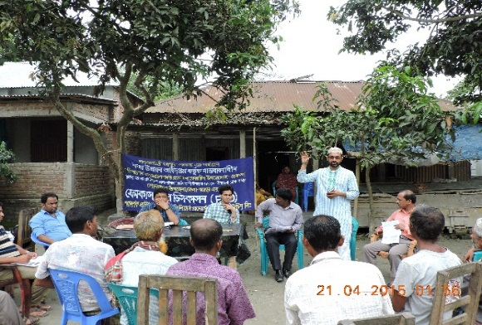
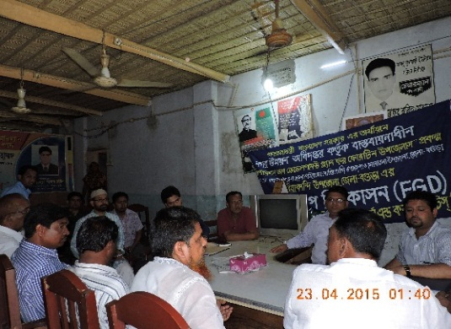
Activities Performed in Inception Stage
Focus Group Discussion (FGD)
Group Discussion in Saghata
Group Discussion in Sonatala
Group Discussion in Sariakandi

Slide 11
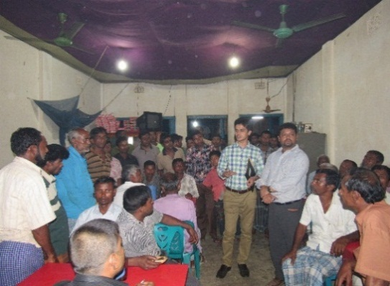
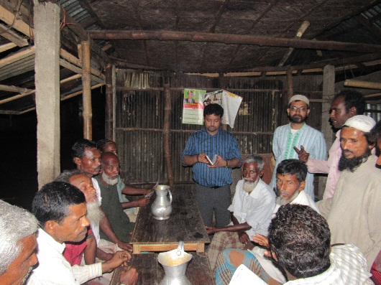
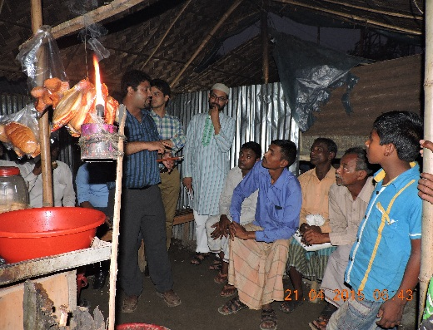
Activities Performed in Inception Stage
Tea Stall Meeting (TSM)
Ghuridaha, Saghata Upazila
Digdair, Sonatala Upazila
Harikal Hat, Sariakandi Upazila

Slide 12
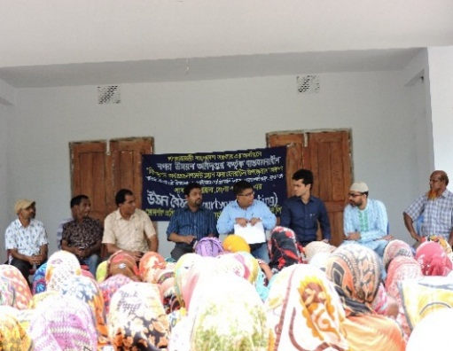
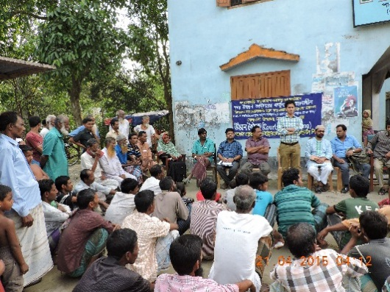
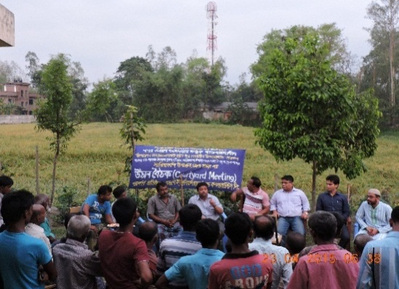
Activities Performed in Inception Stage
Courtyard Meeting (CM)
Courtyard Meeting in Saghata
Courtyard Meeting in Sonatala
Courtyard Meeting in Sariakandi

Slide 13
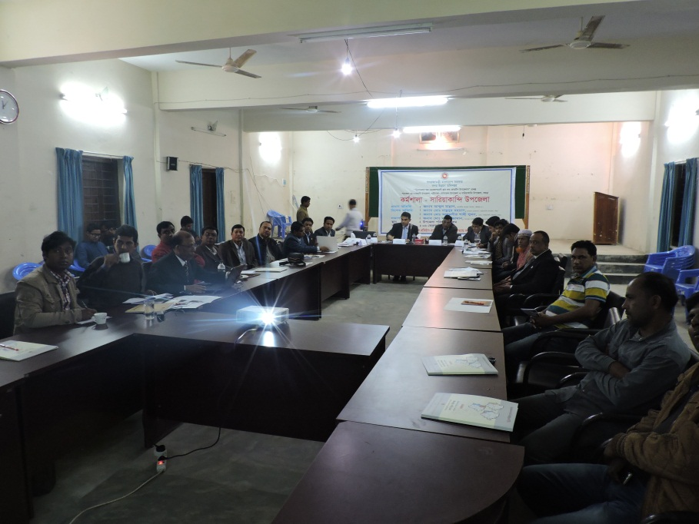
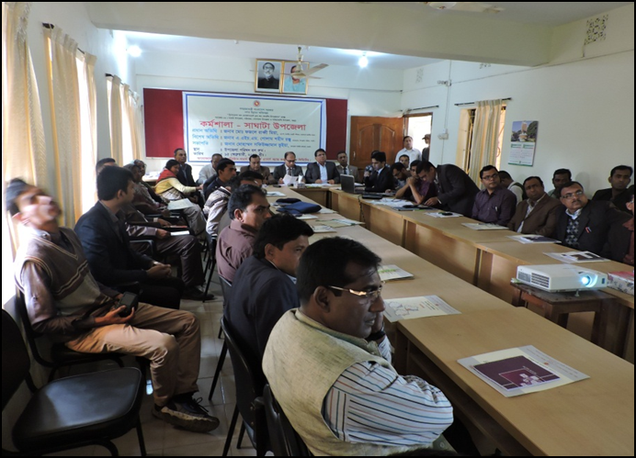
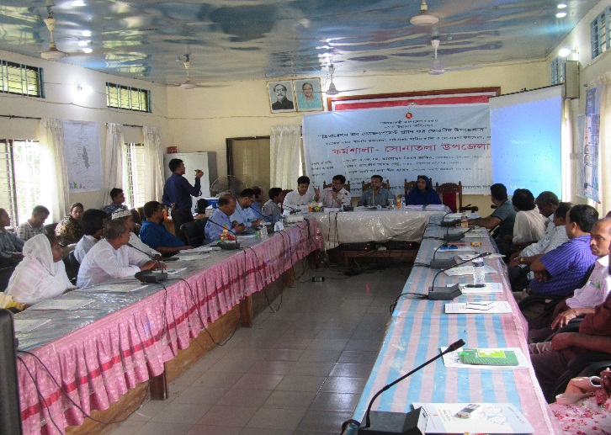
Workshop/Seminar
Workshop at Sariakandi Upazila
Workshop at Saghata Upazila
Workshop at Sonatala Upazila

Slide 14
Participatory Rural Appraisal (PRA)
Purpose of PRA
To involve local people in the planning process by letting them identify their own problems, potentials, development needs and planning priorities for next 20 years;
Supplement and facilitate matching PRA findings with different sectoral findings, particularly spatial analysis;
To make participants own the project and its activities towards realizing participatory planning approach.
PRA Tools
Social/Resource Mapping
Problems and Potentials Venn Diagram
Technology of Participation (ToP)/Consensus Workshop.

Slide 15
Participatory Rural Appraisal (PRA)
Number of Conducted PRA in Project Area
Name of Upazila | No. of Unions | No. of Municipalities | Number of Conducted PRA |  |  | No. of Participants | Time
 |  |  | Union Level | Paurashava Level | Total
Saghata | 10 | - | 10 | - | 10 | 230 | June 9 -16, 2015
Sonatala | 7 | 1 | 7 | 3 | 10 | 178 | June 15-22, 2015
Sariakandi | 12 | 1 | 12 | 4 | 16 | 236 | June 23-30, 2015
Total | 29 | 2 | 29 | 7 | 36 | 644

Slide 16
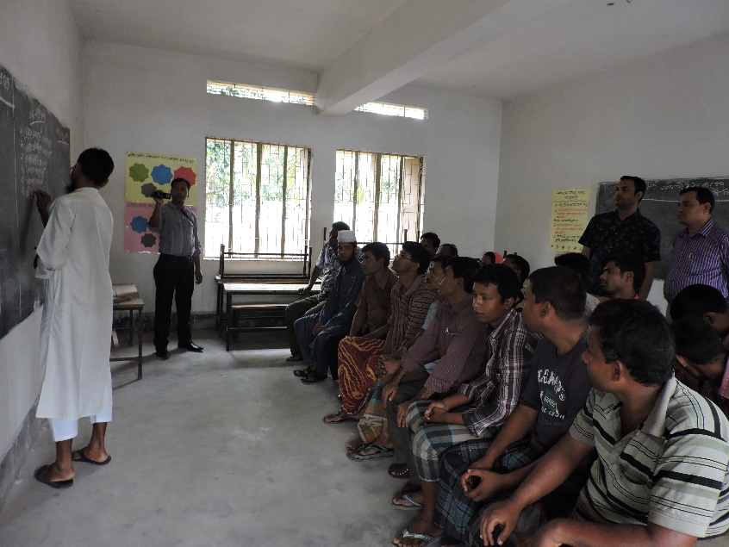
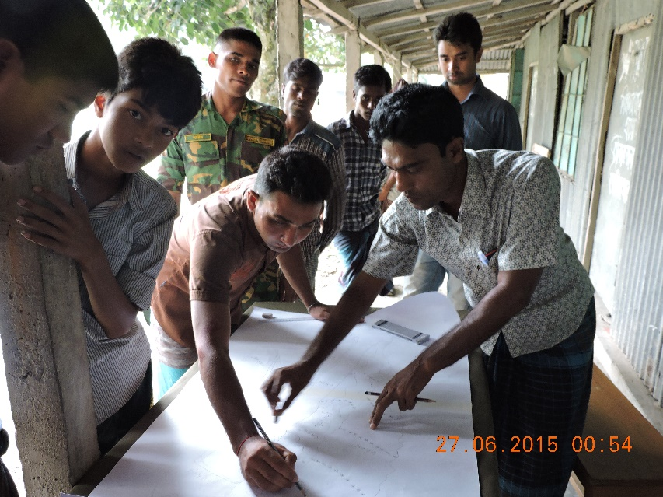
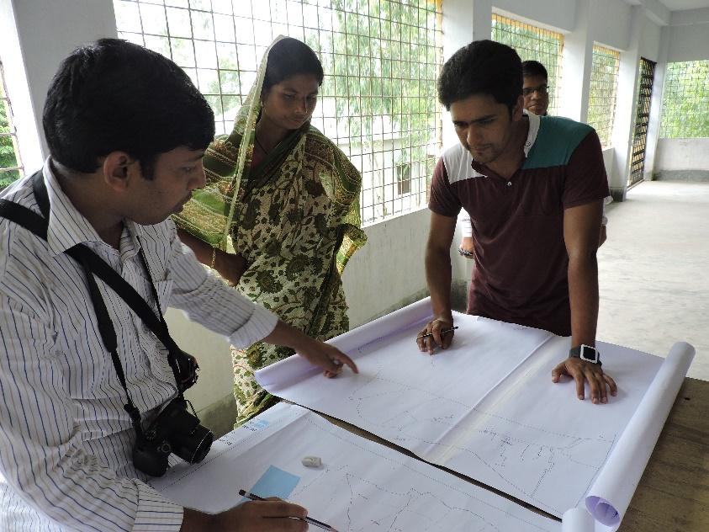
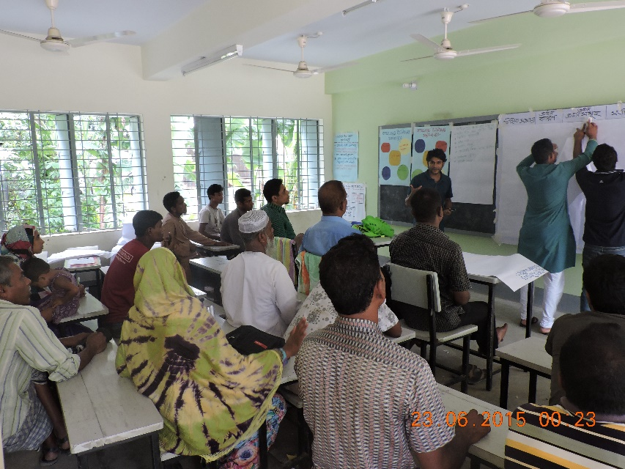
Participatory Rural Appraisal (PRA)
PRA at Sariakandi Upazila
PRA at Saghata Upazila
PRA at Sonatala Upazila
PRA at Sariakandi Upazila

Slide 17
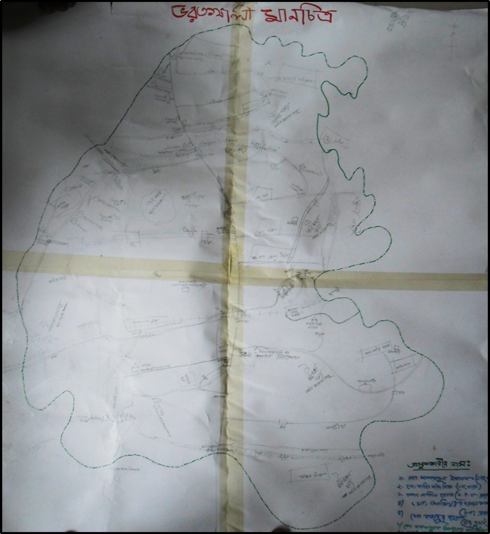
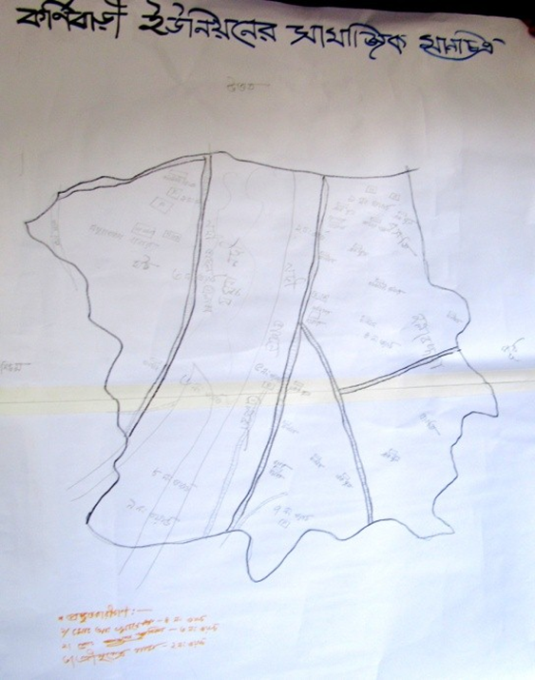
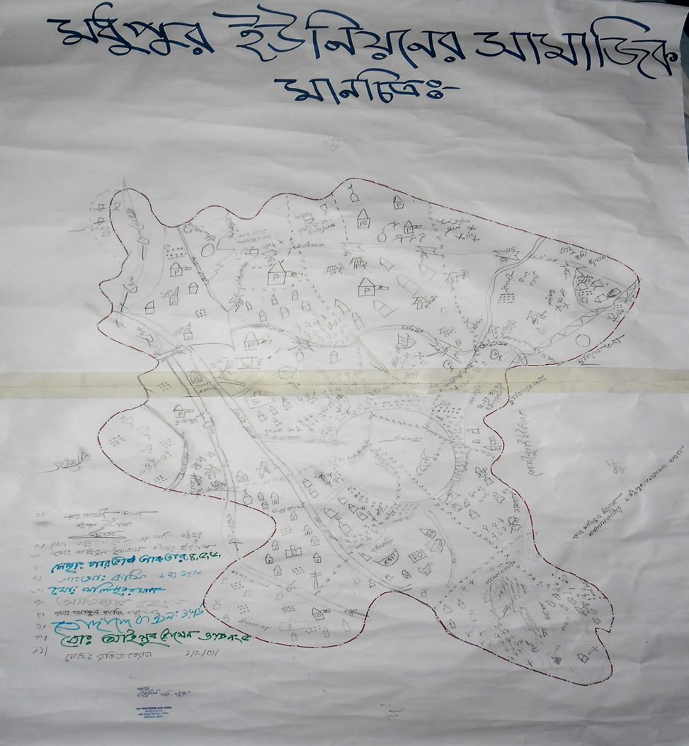
PRA Findings: Resource Map of Study Area
Social Map of Bharatkhali Union in
Saghata Upazila
Social Map of Karnibari Union in
Sariakandi Upazila
Social Map of Madhupur Union in
Sonatala Upazila

Slide 18
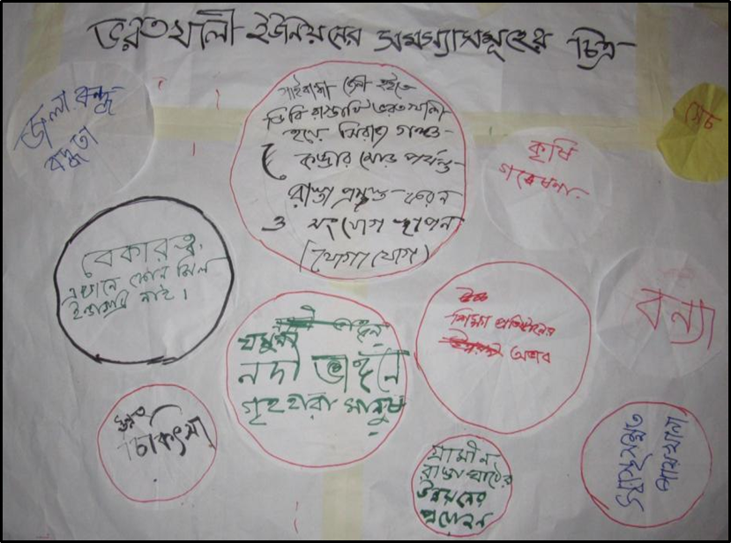
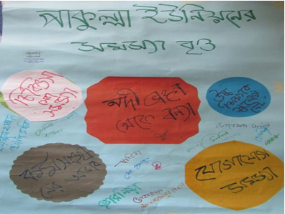
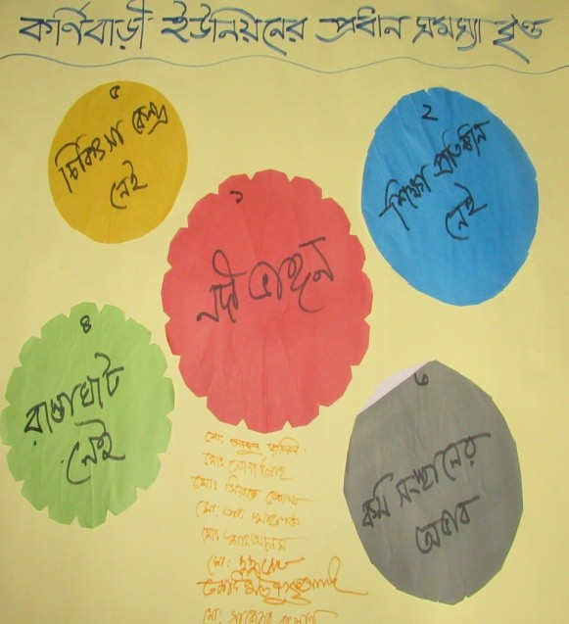
PRA Findings: Major Problems
Major Problems Venn Diagram of Bharatkhali Union of Saghata Upazila
Major Problems Venn Diagram of Pakulla
Union of Sonatala Upazila
Major Problems Venn Diagram of Karnibari
Union of Sariakandi Upazila

Slide 19
PRA Findings: Major Problems
Sonatala | Sariakandi | Saghata
River bank erosion; Problems of drainage system/Water logging; Problem of communication- road, bridge and culvert repair issues; Problem of electricity (absence of connection); Lack of proper education and institutional infrastructure; Sanitation/Problem of public toilet; Natural calamity such as flood, drought. Insufficient medical facility. | River bank erosion; Problems of drainage system/Water logging; Problem of communication- road, bridge & culvert repair issues; Problem of electricity (absence of connection); Insufficient medical facility; Lack of proper education and institutional infrastructure; Sanitation/Problem of public toilet; Natural calamity such as flood, drought. | River bank erosion; Problems of drainage system/Water logging; Problem of communication- road, bridge and culvert repair issues; Problem of electricity (absence of connection); Insufficient medical facility; Lack of proper education and institutional infrastructure; Sanitation/Problem of public toilet; Natural calamity such as flood, drought, river dam, sluicegate; Unemployment; Lack of agricultural facilities/ storage.
Source: Field Survey 2016

Slide 20
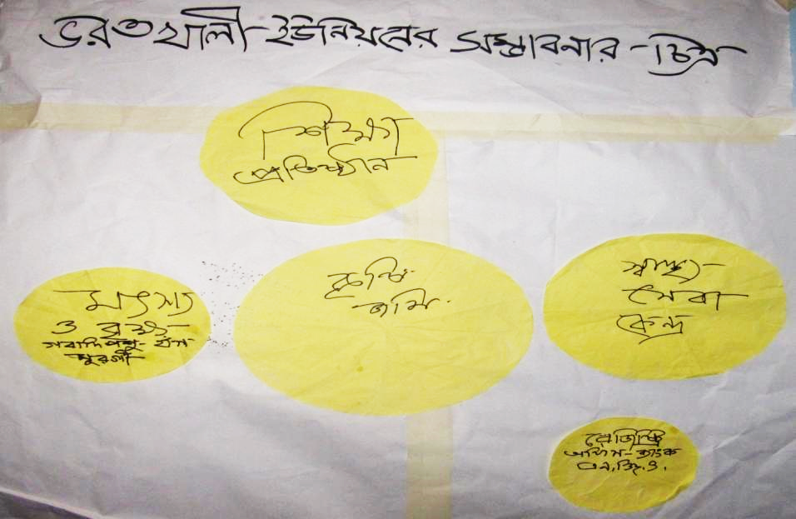
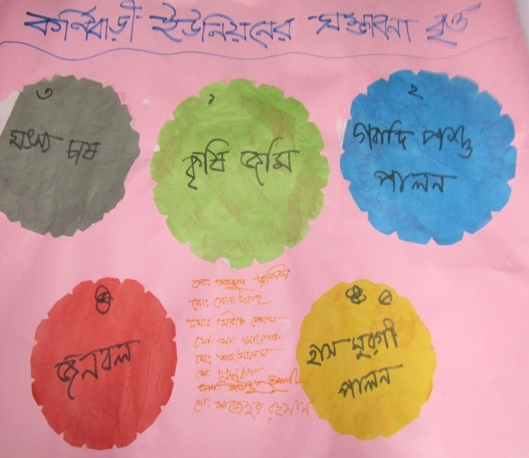
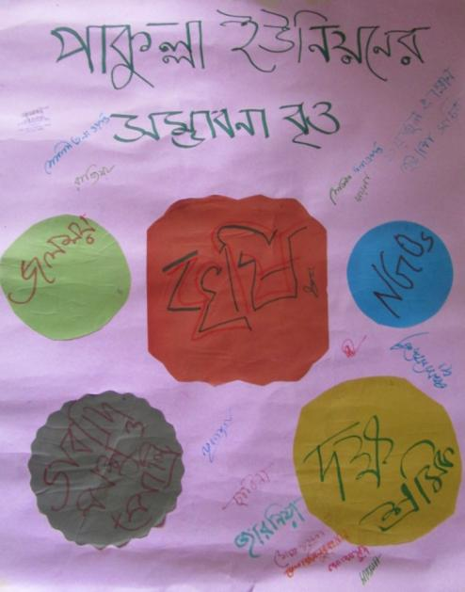
PRA Findings: Major Potentials

Slide 21
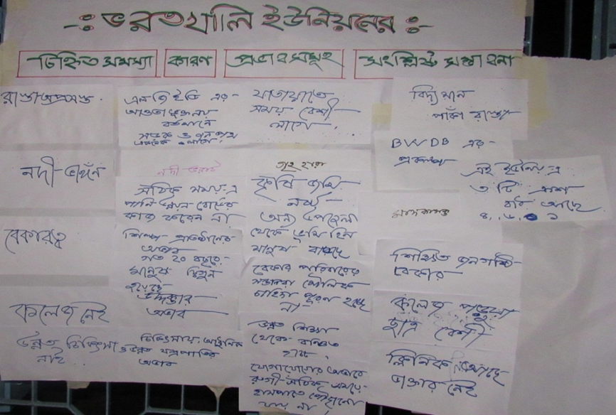
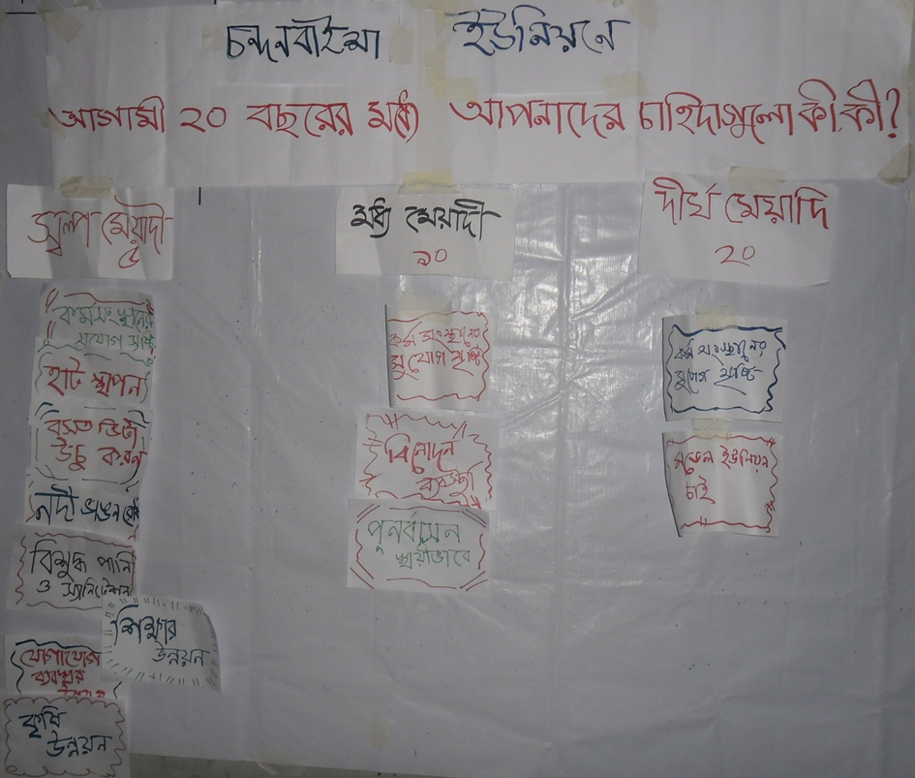
PRA Findings: Perceived Development Priorities
Source: Field Survey 2016
Source: Field Survey 2016

Slide 22
PRA Findings: Perceived Development Priorities
 | Sonatala | Sariakandi | Saghata
Short Term | Protection of river bank; Improvement of gas & water supply; Drainage Master Plan implementation; Waste management system; Development of recreational facilities. | Drainage system; Need of 100% sanitation; Demand of river embankment; 100% electricity; Permanent shelter building | Drainage system; Unemployment; River bank erosion; Electricity installation; Eradication of unemployment problem
Mid Term | Employment generation; Industrialization; Development of agriculture system. | Demand of employment opportunity; Need of Pure drinking water; Development of agriculture system; Stipends for poor students. | Developing the education system; Developing industrialization; Transforming a model union
Long Term | Modern healthcare; Planned urbanization; 100 percent electrification; Development of education system; Improved communication system. | Good communication system; Development of health services; Demand of employment opportunity; Infrastructure development. | Standard education system; Modern healthcare system.
Source: Field Survey 2016

Slide 23
Photogrammetry Work
Satellite Image Collection
Image Sensor: World View-2, World View-3, GeoEye-1, Ikonos, QuickBird
Type: Ortho ready stereo (3D)
Resolution: 1.0m Panchromatic, 4.0 meter Multispectral
Source: New Acquisition, 16thOrctober 2015
Bit Rate: 16 Bit
Company: DigitalGlobe Inc., USA
1.0 Meter Mono Image
(3D Image)

Slide 24
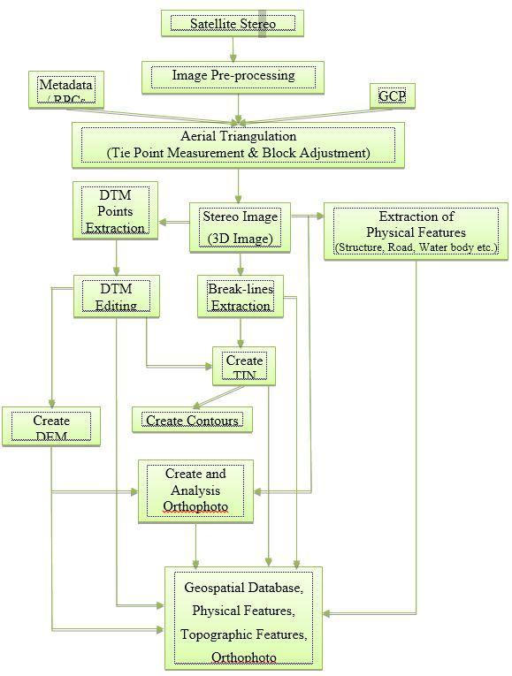
Processing of Satellite Image

Slide 25
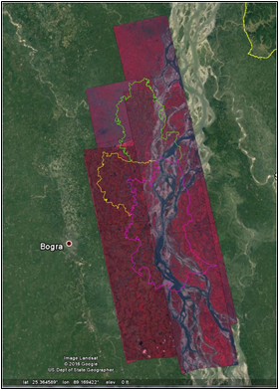
Processing of Satellite Image
Tiles of sample satellite image color and contrast balance
Merged sample satellite image with color and contrast balance

Slide 26
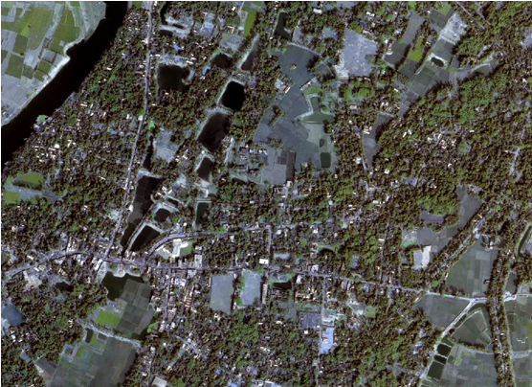
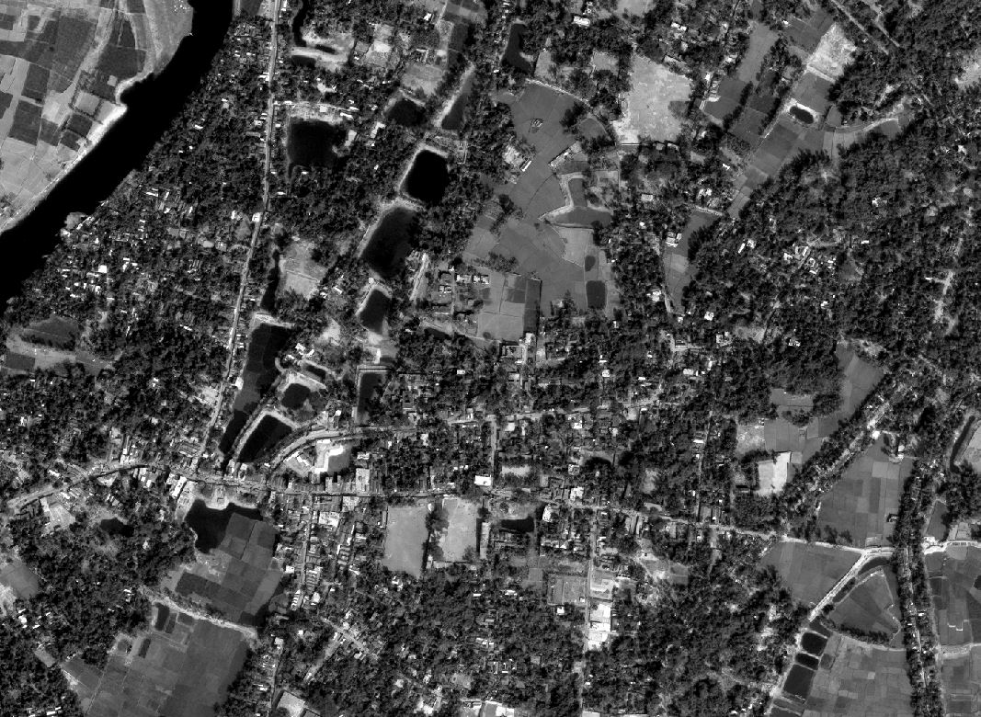
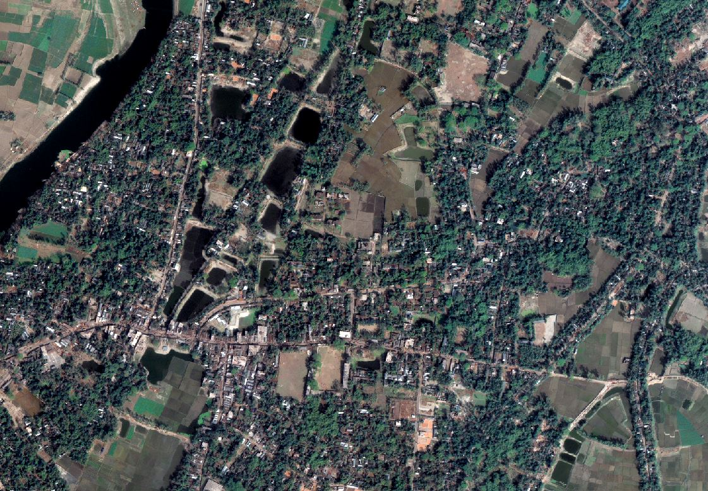
Satellite Image Pre-Processing
Satellite Image Multispectral Image
Satellite Image Panchromatic 1.0 Meter
Pan-sharpen Image- multispectral 1.0 meter

Slide 27
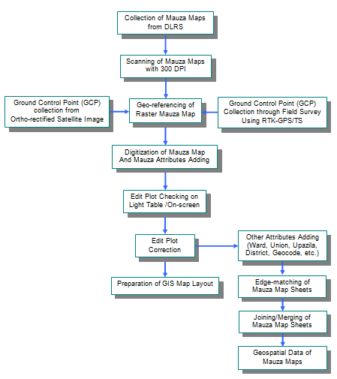
GIS Database Development of Mauza Maps
Flow Diagram for Preparation of GIS Database using RS Mauza Map

Slide 28
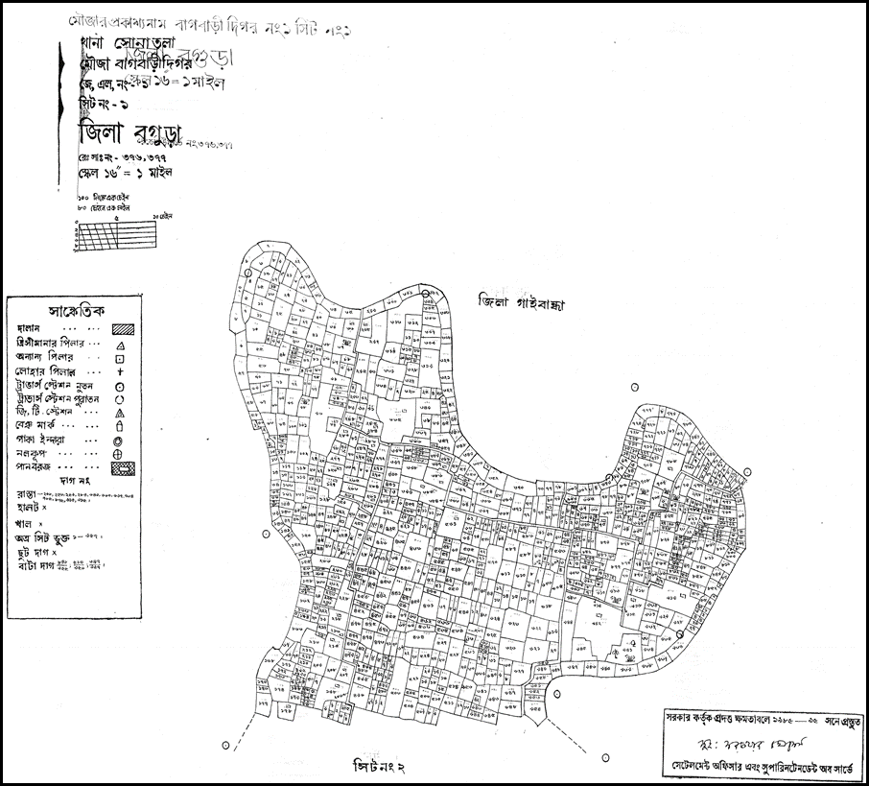
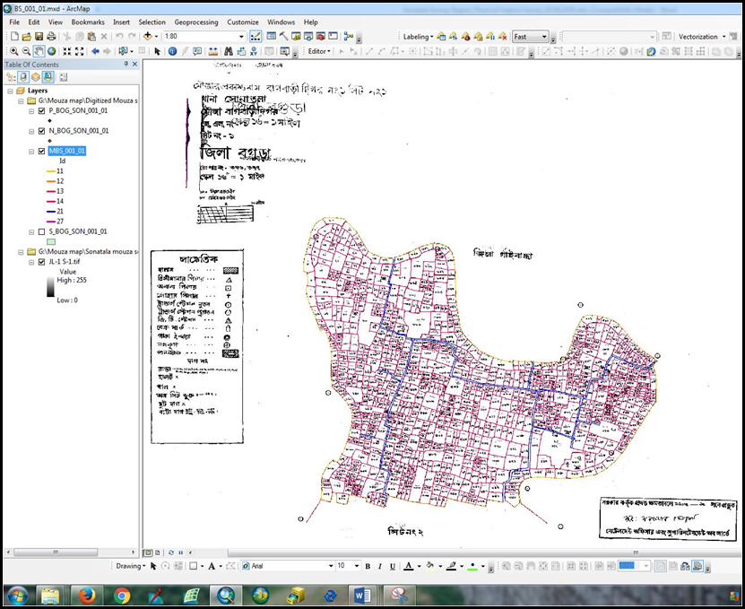
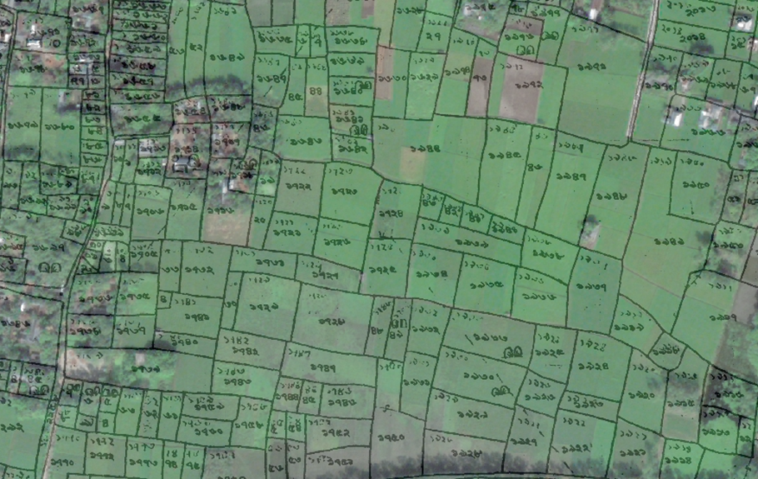
GIS Database Development of Mauza Maps
Sample of Scanned Mouza Map from DSLR
On Screen Digitization and Sample Digitized Mauza Map
Sample Geo-referenced Raster Mauza Map Overlaid on Satellite Image

Slide 29
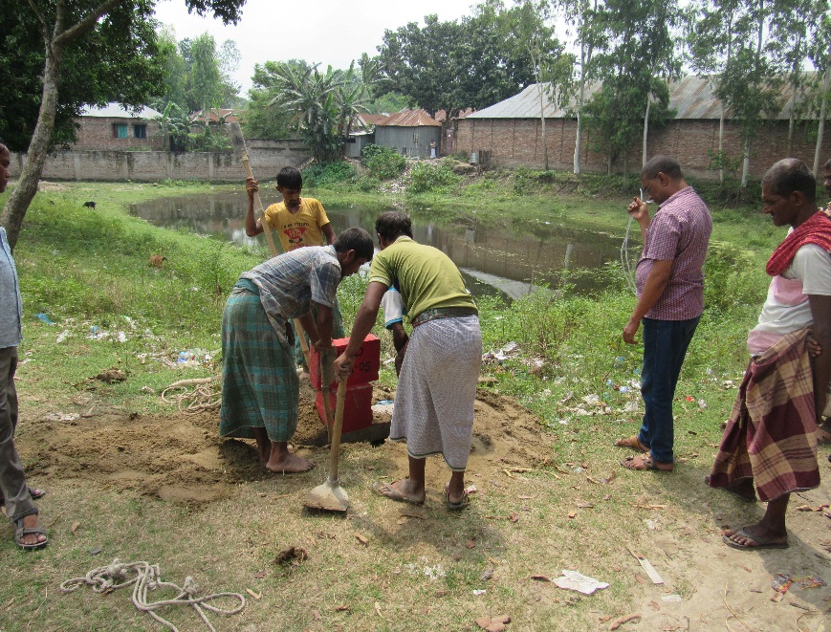
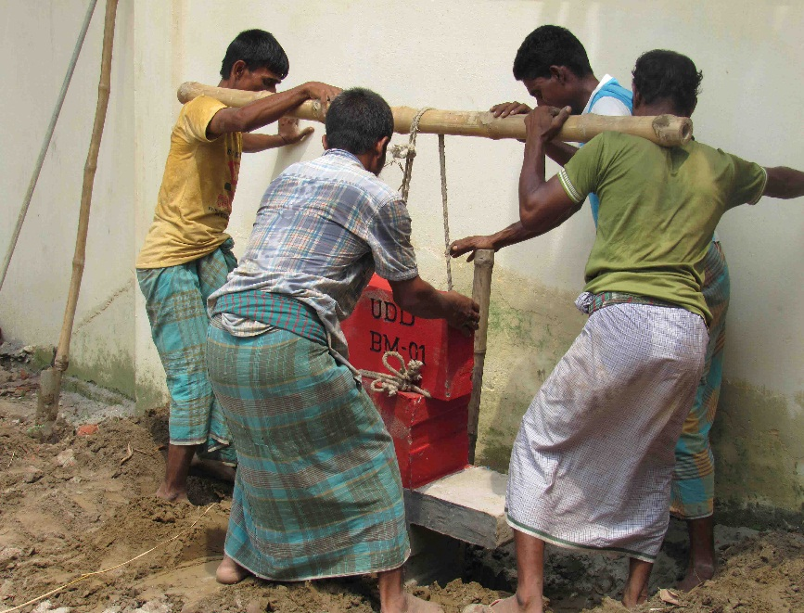
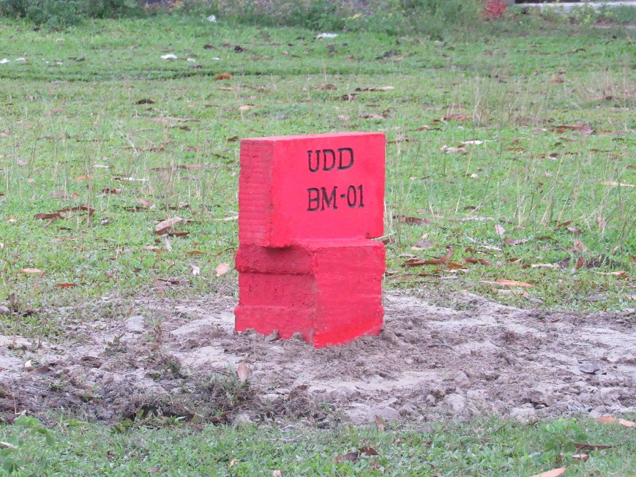
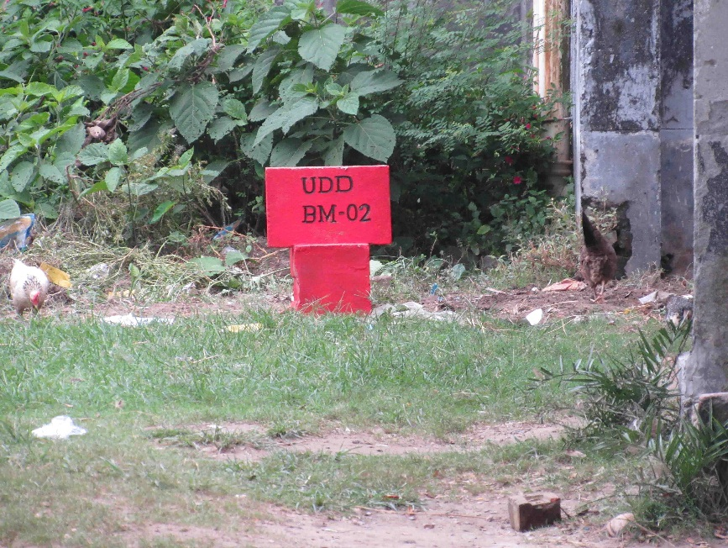
BM Pillar Installation
BM Pillar Installation in 3 Upazilas

Slide 30
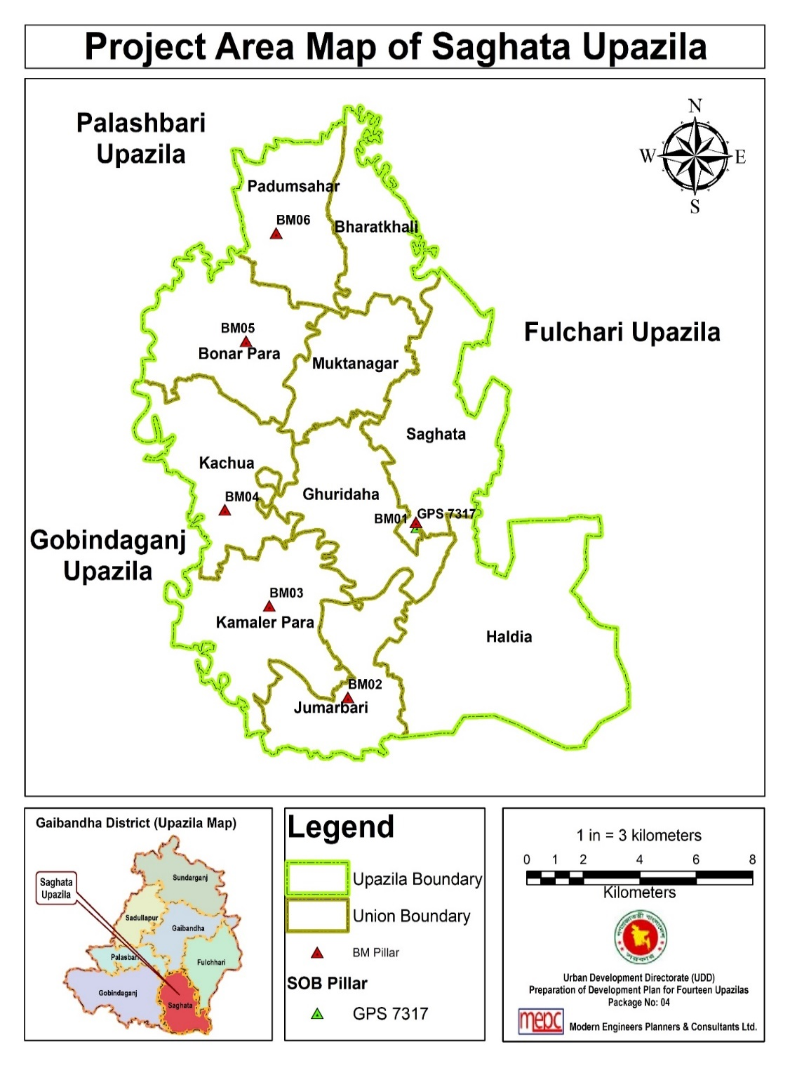
Location of BM Pillars
Point ID | Location | Latitude (WGS 84) | Longitude (WGS 84) | Height above MSL (in meter)
GPS 7317 | SOB 7317, Saghata Pilot High School | 25.10891872720 | 89.5846187158 | 19.5422
BM No. | R.L (m) | Easting (dd) | Northing (dd) | Location
BM-01 | 19.4942 | 760609.585 | 2779666.859 | Saghata Thana
BM-02 | 20.4632 | 758197.209 | 2773725.556 | Jumarbari Adarsha College
BM-03 | 18.0182 | 755409.581 | 2776827.551 | Kamalerpara union Parishad
BM-04 | 18.1802 | 753838.397 | 2780087.644 | Kachua union Parishad
BM-05 | 18.9942 | 754590.647 | 2785807.956 | Kazi Azhar Ali Model High School
BM-06 | 19.9722 | 755656.441 | 2789474.205 | Padumsahar union Parishad

Slide 31
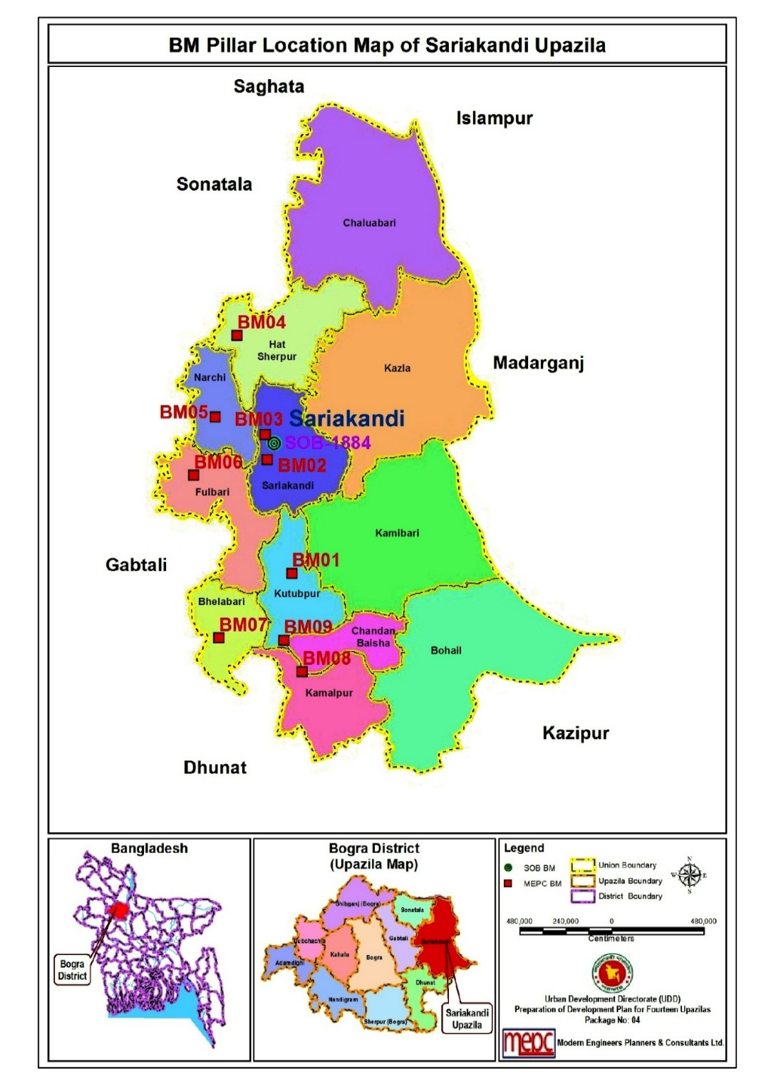
Location of BM Pillars
BM No. | R.L (m) | Easting (dd) | Northing (dd) | Location
BM-01 | 15.487 | 760880.478 | 2748843.087 | Boroikandi BK High School
BM-02 | 17.161 | 759594.318 | 2754779.746 | Sariakandi Public Field
BM-03 | 17.308 | 759482.732 | 2756080.825 | Sariakandi Sadar Union
BM-04 | 16.821 | 758028.503 | 2761248.746 | Nizbolail Islamia Alim Madrasa
BM-05 | 17.955 | 756885.929 | 2756995.465 | Narchi Union Parisad, Sariakandi
BM-06 | 15.772 | 755766.448 | 2753950.831 | Phulbari Union Digital Centre
BM-07 | 15.487 | 757076.374 | 2745471.445 | Jorgacha UP
BM-08 | 15.739 | 761414.319 | 2743720.090 | Koritala High School
BM-09 | 15.627 | 760453.251 | 2745357.997 | Chandan Baisha Degree College

Slide 32
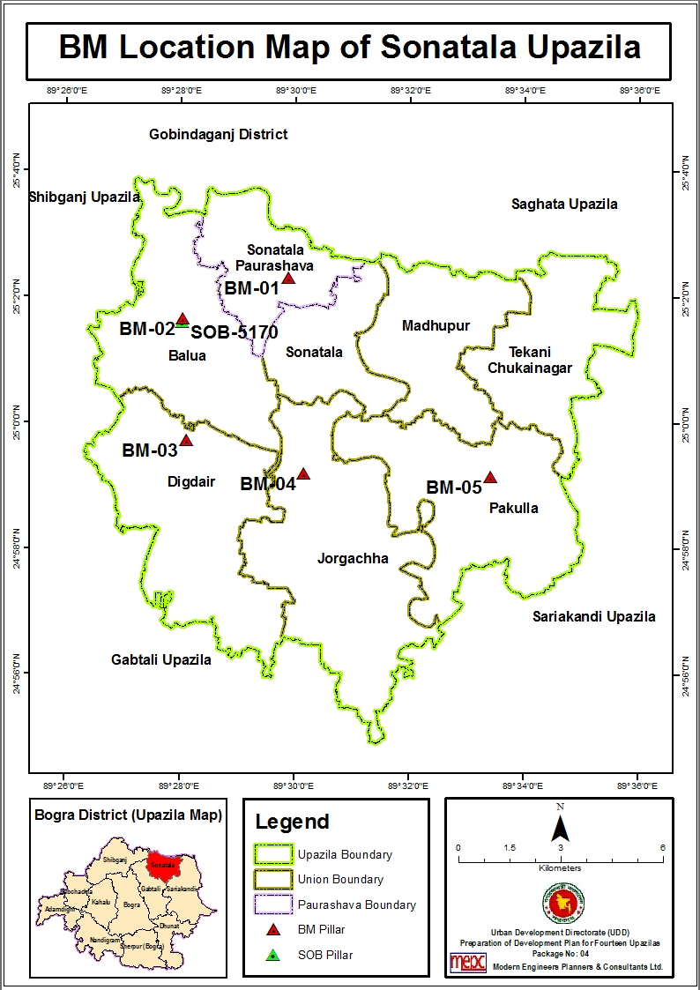
Location of BM Pillars
Location of Reference BM
Point ID | Location | Easting (dd) | Northing (dd) | RL (in meter)
GPS-5170 | South edge of Baluahat Non-govt. High School’s compound. Village: Baro Balua, Upazila: Sonatala, | 748975.252 | 2770156.121 | 17.792
Coordinates and Descriptions of the BM Pillars
BM No. | R.L (m) | Easting (dd) | Northing (dd) | Location
BM-01 | 17.551 | 752041.314 | 2771507.181 | Sonatala Stadium Shahid Minar
BM-02 | 17.722 | 748979.461 | 2770265.836 | Baluahat High School, Sonatala
BM-03 | 17.918 | 749157.339 | 2766691.469 | Korpur High School
BM-04 | 17.462 | 752625.298 | 2765788.272 | Jorgachha Union Parishad
BM-05 | 17.388 | 758109.885 | 2765805.850 | Pakulla Union Parishad Sonatala

Slide 33
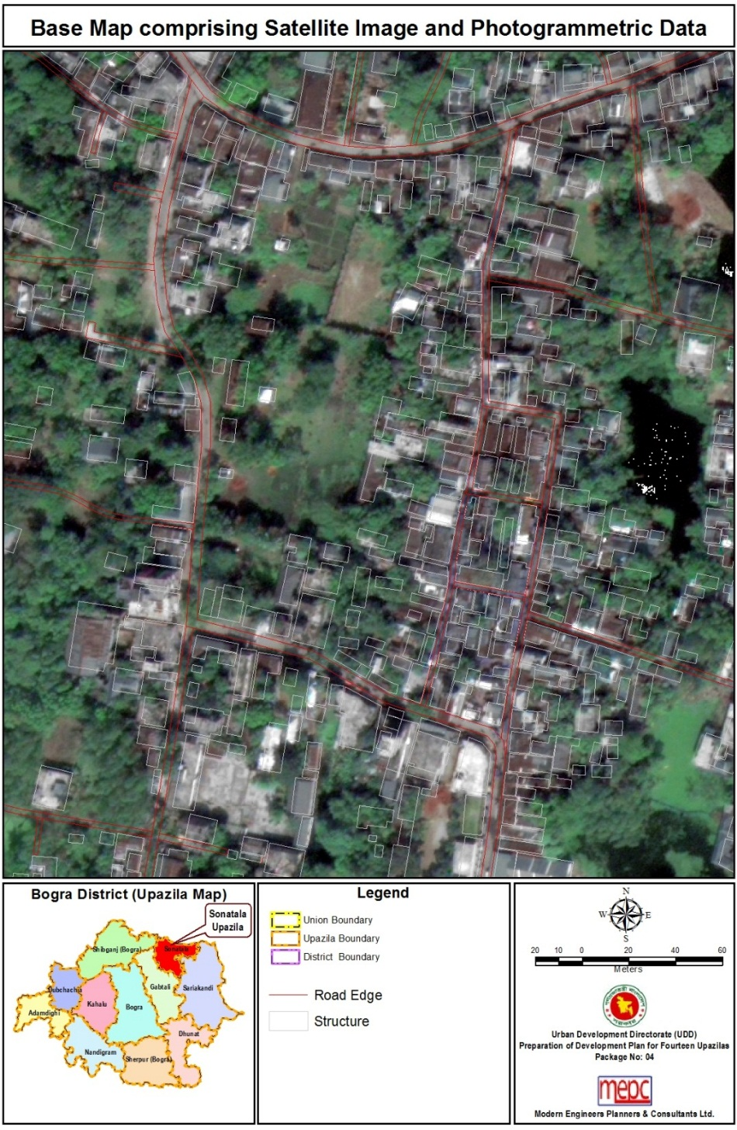
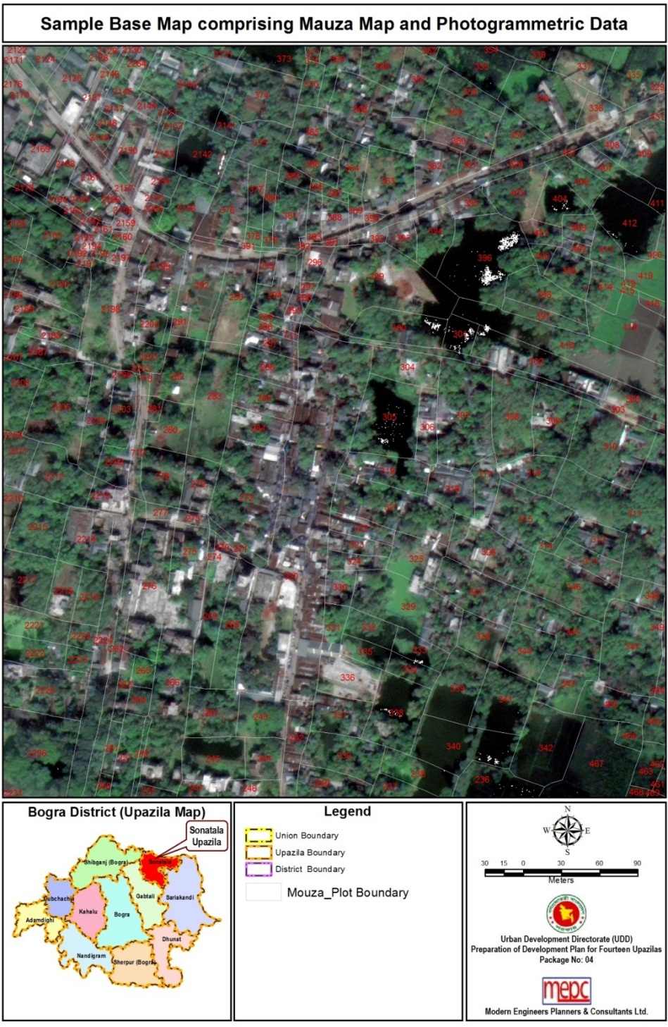
Sample Base Map Comprising Mauza Map and Photogrammetric Data

Slide 34
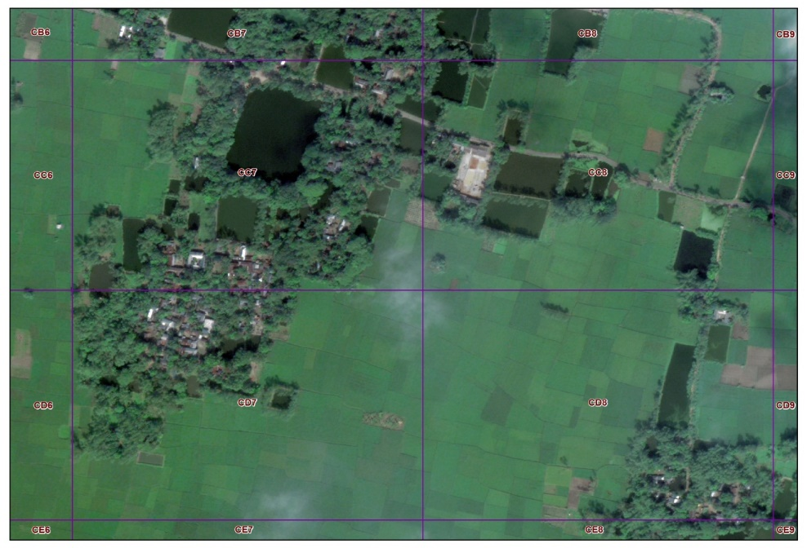
Field Survey (Physical Features, Land Use & Topographic)
Grids for Survey Base Maps of Sonatala
Grids for Survey Base Maps of Sariakandi
Grids for Survey Base Maps of Saghata

Slide 35
Field Survey (Physical Features, Land Use & Topographic)
Survey Base Map of Sonatala Upazila in Grids
(A3 Size)
A Sample Surveyed Scanned Base Map for Physical Features and Land Use Survey

Slide 36
Field Survey (Physical Features, Land Use & Topographic)
Sample Log Book Page with Information Recorded in Field
Surveyors Working on the Field

Slide 37
Physical Feature Survey: Data Processing & Analysis
Updating Works through GIS
Attribute Table of Structure Database of Sonatala Upazila

Slide 38
Topographical Ground Truthing Survey by RTK-GPS

Slide 39
Physical Feature Survey: Major Findings

Slide 40
Physical Feature Survey: Major Findings
Structure Use | Number of Structure | Percentage (%)
Agriculture | 280 | 0.47
Commercial Activities | 1787 | 3.01
Community Service | 46 | 0.08
Education and Research | 528 | 0.89
Government Service | 63 | 0.11
Health Service | 33 | 0.06
Manufacturing & Processing Activity | 185 | 0.31
Miscellaneous | 486 | 0.82
Mixed Use | 58 | 0.10
Non-Government Services | 11 | 0.02
Religious | 399 | 0.67
Residential | 55327 | 93.21
Service Activity | 98 | 0.17
Transport & Communication | 18 | 0.03
Unknown | 37 | 0.06
Grand Total | 59356 | 100.00

Slide 41
Physical Feature Survey: Major Findings
Structure Use | Number of Structure | Percentage (%)
Agriculture | 280 | 0.47
Commercial Activities | 1787 | 3.01
Community Service | 46 | 0.08
Education and Research | 528 | 0.89
Government Service | 63 | 0.11
Health Service | 33 | 0.06
Manufacturing & Processing Activity | 185 | 0.31
Miscellaneous | 486 | 0.82
Mixed Use | 58 | 0.10
Non-Government Services | 11 | 0.02
Religious | 399 | 0.67
Residential | 55327 | 93.21
Service Activity | 98 | 0.17
Transport & Communication | 18 | 0.03
Unknown | 37 | 0.06
Grand Total | 59356 | 100.00

Slide 42
Land Use Survey
Serial No. | Land Use Type | Area (Sq. km.) | Percentage (%)
1 | Agriculture | 104.31 | 45.78
2 | Char Land | 15.52 | 6.81
3 | Circulation Network | 1.71 | 0.75
4 | Commercial | 0.39 | 0.17
5 | Community Service | 0.00 | 0.00
6 | Education and Research | 0.07 | 0.03
7 | Government Services | 0.07 | 0.03
8 | Group of Trees / Forest | 0.32 | 0.14
9 | Health Services | 0.02 | 0.01
10 | Manufacturing and Processing Activities | 0.13 | 0.06
11 | Mixed Use | 0.00 | 0.00
12 | Recreational Facilities | 0.00 | 0.00
13 | Religious | 0.05 | 0.02
14 | Residential | 32.60 | 14.31
15 | Restricted Area | 0.00 | 0.00
16 | Sand/Sand Dunes | 22.58 | 9.91
17 | Service Activity | 0.00 | 0.00
18 | Transport & Communication | 0.12 | 0.05
19 | Vacant Land | 0.02 | 0.01
20 | Water Body | 49.59 | 21.76
Grand Total |  | 227.85 | 100.00

Slide 43
Land Use Survey
Serial No. | Land Use Type | Area (Acre) | Area (Sq. km.) | Percentage (%)
1 | Agriculture | 31486.694 | 127.42 | 30.87
2 | Char Land | 13556.931 | 54.862 | 13.29
3 | Circulation Network | 253.807 | 1.027 | 0.25
4 | Commercial | 45.679 | 0.184 | 0.04
5 | Community Service | 0.00 | 0.00 | 0.00
6 | Education and Research | 56.067 | 0.227 | 0.05
7 | Government Services | 18.381 | 0.074 | 0.02
8 | Group of Trees / Forest | 2.354 | 0.009 | 0.00
9 | Health Services | 6.666 | 0.027 | 0.01
10 | Manufacturing and Processing Activities | 63.261 | 0.256 | 0.06
11 | Mixed Use | 55.182 | 0.223 | 0.05
12 | Recreational Facilities | 0.006 | 0.00002 | 0.00
13 | Religious | 6.969 | 0.028 | 0.01
14 | Residential | 7263.264 | 29.393 | 7.12
15 | Restricted Area | 0.00 | 0.00 | 0.00
16 | Sand/Sand Dunes | 17226.021 | 69.711 | 16.89
17 | Service Activity | 0.087 | 0.0004 | 0.00
18 | Transport and Communication | 0.016 | 0.00007 | 0.00
19 | Vacant Land | 1.587 | 0.006 | 0.00
20 | Water Body | 31960.02 | 129.337 | 31.33
Grand Total |  | 38936.11 | 157.57 | 100.00

Slide 44
Land Use Survey
Serial No. | Land Use Type | Area (Acre) | Area (Sq. km.) | Percentage (%)
1 | Agriculture | 21858.67 | 88.46 | 56.14
2 | Char Land | 2659.93 | 10.76 | 6.83
3 | Circulation Network | 264.30 | 1.07 | 0.68
4 | Commercial | 99.48 | 0.40 | 0.26
5 | Community Service | 0.57 | 0.00 | 0.00
6 | Education and Research | 66.55 | 0.27 | 0.17
7 | Government Services | 15.48 | 0.06 | 0.04
8 | Group of Trees/Forest | 1871.40 | 7.57 | 4.81
9 | Health Services | 3.80 | 0.02 | 0.01
10 | Manufacturing and Processing Activities | 35.34 | 0.14 | 0.09
11 | Mixed Use | 0.35 | 0.00 | 0.00
12 | Recreational Facilities | 3.68 | 0.01 | 0.01
13 | Religious | 21.05 | 0.09 | 0.05
14 | Residential | 5067.26 | 20.51 | 13.01
15 | Restricted Area | 0.94 | 0.00 | 0.00
16 | Sand/Sand Dunes | 1175.46 | 4.76 | 3.02
17 | Service Activity | 0.40 | 0.00 | 0.00
18 | Transport and Communication | 0.03 | 0.00 | 0.00
19 | Vacant Land | 1.28 | 0.01 | 0.00
20 | Water Body | 5790.16 | 23.43 | 14.87
Grand Total |  | 38936.11 | 157.57 | 100.00

Slide 45
Topographic Survey Findings
Summary of Spot Level Data of Saghata Upazila
Total Spot Level Points | 568930
Highest Elevation | 21.743m
Lowest Elevation | -0.997m
Mean | 17.527m
Standard Deviation | 3.003m

Slide 46
Topographic Survey Findings
Summary of Spot Level Data of
Sariakandi Upazila
Total Spot Level Points | 1030880
Highest Elevation | 21.744 m
Lowest Elevation | -2.459 m
Mean | 14.209 m
Standard Deviation | 3.793

Slide 47
Topographic Survey Findings
Summary of Spot Level Data of Sonatala Upazila
Total Spot Level Points | 396930
Highest Elevation | 21.743m
Lowest Elevation | 2.140m
Mean | 17.149m
Standard Deviation | 2.804m

Slide 48
Topographic Survey Findings
Summary of Contour Line Data of Saghata
Total Contour Line | 638031
Highest Elevation | 22.89m
Lowest Elevation | 0.00m
Mean | 17.67m
Standard Deviation | 1.858m

Slide 49
Topographic Survey Findings
Summary of Contour Line Data of Sariakandi
Total Contour Line | 10000
Highest Elevation | 22.17 m
Lowest Elevation | 12.81 m
Mean | 17.86 m
Standard Deviation | 1.500

Slide 50
Topographic Survey Findings
Summary of Contour Line Data of Sonatala
Total Contour Line | 500588
Highest Elevation | 0.03m
Lowest Elevation | 22.77m
Mean | 17.76m
Standard Deviation | 1.697m

Slide 51
3D Visualization of Physical Features
3D Display of Physical Features in Sonatala Town Area
3D Display of Physical Features in Sariakandi Town Area
3D Display of Physical Features in Saghata Town Area

Slide 52
Physical Feature Survey Photographs

Slide 53
Socio-economic Survey
Objectives of the Survey
To understand demographic and socio-economic characteristics of households and population;
To understand Union and Pourashava/Upazila HQ (as the case may be) service provisions, including infrastructure and social facilities;
To understand situation of access to the essential services and facilities by the inhabitants; and
To suggest some concrete recommendations for the development of Upazila.
Determination of Sample and Sample Size
The survey has been conducted through administering a pre-designed Household Questionnaire in Bangla, which was finalized in consultation with the Client (UDD). Based on Project Director’s office recommendation, Sample Household size of each Upazila are:
Saghata- 1,115
Sariakandi- 1,113
Sonatala- 1,111

Slide 54
Socio-economic Survey: Major Findings
Source: Field Survey 2016
Source: Field Survey 2016
Source: Field Survey 2016

Slide 55
Socio-economic Survey: Major Findings
Source: Field Survey 2016
Source: Field Survey 2016
Source: Field Survey 2016

Slide 56
Socio-economic Survey: Major Findings
Source: Field Survey 2016
Source: Field Survey 2016
Source: Field Survey 2016

Slide 57
Socio-economic Survey: Major Findings
Source: Field Survey 2016
Source: Field Survey 2016
Source: Field Survey 2016

Slide 58
Socio-economic Survey Photographs

Slide 59
Formal-Informal Economy Survey
1. Formal Economic Sector
Economic Group;
Bank/Bima, NGO;
Haat/Bazar, Growth Centre;
Industry.
2. Informal Economic Sector
Road side/Footpath market;
Mobile hawker;
Daily Wage earners group;
Homemade product business;
Agriculture.
Determination of Sample and Sample Size
The survey has been conducted through administering a pre-designed household questionnaire in Bengali, which was finalized in consultation with the client (UDD). Based on Project Director’s office recommended formula, sample household size of each Upazila.
Saghata- 1,115
Sariakandi- 1,113
Sonatala- 1,192

Slide 60
Formal-Informal Economic Survey: Major Findings
Source: Field Survey 2016
Source: Field Survey 2016
Source: Field Survey 2016

Slide 61
Formal-Informal Economic Survey: Major Findings
Source: Field Survey 2016
Source: Field Survey 2016
Source: Field Survey 2016

Slide 62
Formal-Informal Economic Survey Photographs
Informal Activities at Saghata
Formal Activities at Sariakandi
Conducting Survey Activities
Informal Activities at Saghata

Slide 63
Shift Share Analysis

Slide 64
Agricultural Survey
Main Objectives
To assess the present cropping pattern and cropping intensities (single, double and triple crop area), land utilization and flood level;
To determine the growth or decline of agricultural land during last ten years (from 2005-2016);
To determine the present scenario in agriculture practices;
Assessment of potential sustainable future development of the sector.

Slide 65
Distribution of Cropped Areas
Percentage of Single, Double & Triple Cropped Area under Sariakandi Upazila
Percentage of Single, Double & Triple Cropped Area under Saghata Upazila
Percentage of Single, Double & Triple Cropped Area under Sonatala Upazila

Slide 66
Agricultural Survey: Major Findings
Growth or Decline Agriculture Land Use during the Last 10 Year in Sonatala Upazila
Growth or Decline Agriculture Land Use during the Last 10 Year in Saghata Upazila
Growth or Decline Agriculture Land Use during the Last 10 Year in Sariakandi Upazila

Slide 67
Agricultural Survey: Major Findings
Union wise Cropping Intensity under Saghata Upazila
Union wise Cropping Intensity under Sariakandi Upazila
Union wise Cropping Intensities under Sonatala Upazila

Slide 68
Agricultural Survey: Major Findings
Major problems
Occurrence of sudden flood and damaged field crops;
Lack of modern agricultural machineries;
Less availability of quality different HYV crop seeds;
River erosion and silted;
Lack of cold storage and vegetable cool-chamber;
Katcha irrigation drainage system and wastage of irrigation water;
Power failure in Boro crop season;
Most of the old canals of the union were found closed due to construction of unplanned development of infrastructures (Market, houses, farms etc.);
Indiscriminate use of water by setting up irrigation pump;
Lack of seed store for high value crops;
Lack of vegetables and fruits whole sale market infrastructure;
Less availability of power tiller/tractor, harvester, sprayer & foot pump and high price;
Lack of modern technologies;
Damage of perishable vegetables due to undeveloped road system and lack of Vehicles for transportation.

Slide 69
Agricultural Survey Photographs
Project Manager (PM) of Package-4 is giving speech on the relation between project and agriculture.
Agriculture Expert is collecting data.
Questionnaire survey for KII and Agriculture

Slide 70
Agricultural Survey Photographs
Brinjal Field with Pheromone Trap at Saghata
Tomato Field at Saghata
Farmers Maize Field at Saghata
Farmers Chili field at Sonatala
Farmers Sugarcane Field at Sonatala
Farmers Vegetable and Rice Field at Sonatala
Boro Rice Field at Sariakandi
Brinjal Field at Sariakandi
Mustard Field at Sariakandi

Slide 71
Traffic & Transportation Survey
Objectives of the Survey
To understand the existing transportation networks and facilities;
To find out the scenario of average daily traffic, peak hour traffic and off- peak hour traffic;
To understand the pattern of traffic generation, traffic distribution and movement, major origin and destination points;
To understand the pattern of traffic generation and traffic distribution in regional context;
To understand the pedestrian flow in measuring the capacity of the road;
To tally the findings of PRA and Socio-economic survey.

Slide 72
Traffic & Transportation Survey
Major Surveys
Traffic Volume Count Survey
Origin and Destination (O-D) Survey
Pedestrian Survey
Bus Passenger Survey
Train Passenger Survey
Regional Road Network Analysis

Slide 73
Traffic & Transportation Survey: Major Findings
Major Trip Distribution Point from O-D Matrix

Slide 74
Traffic & Transportation Survey: Major Findings
Origin-Destination (O-D) Pedestrian Survey Findings

Slide 75
Traffic & Transportation Survey Photographs
Madrasa Mor Intersection
CNG Stand at Hindu Kandi Mor
Surveyors Conducting Train Passenger Survey

Slide 76
Hydrological Survey
Overall Objectives of the Survey Works
Bathymetric survey of Bangali River.
Identification of hydraulic structures and collecting information regarding capacity and sill levels of the structures.
Identification of flood hazard locations.
Identification of flow directions.
Collection of observed flood levels in the field.
Collecting information of any existing drainage system.
Identification of water logging zones.
Collecting information regarding encroachments of natural water bodies and drains.
Collection of water level, discharge and rainfall data from secondary sources.

Slide 77
Hydrological Survey: Data Collection
Bathymetric Survey of the Major Rivers of Saghata, Sariakandi and Sonatala Upazila
Bathymetric Survey of Jamuna and Bangali River at Sonatala Upazila has been done.
Bathymetric Survey of Jamuna, Bangali and Alail River at Saghata Upazila has been done.
Bathymetric Survey of Jamuna, Bangali & Ichakhali Rivers at Sariakandi Upazila has been done.
During Bathymetric Survey, observed water levels in the field are collected.
Tidal effects were assessed.
Right Bank of Bangali River at the bridge on Ghorapir road near Sonatala
The Confluence Point of Alai River and Katakhali (Bangali) River near Ramnagar Bazar

Slide 78
Hydrological Survey
During Physical Feature survey:
Information regarding hydraulic structures has been collected.
Information of existing drains regarding depth & width, RL and GPS locations at different junction points, starti-ng points and ending points are obtained
Frequent flash flood hazard zones were identified.
Flow directions of the rivers and khals were observed.
Frequent water logging zones were collected.
Information regarding encroachment of natural water bodies were collected.
Water level, discharge and rainfall data has been collected from BWDB.

Slide 79
Hydrological Survey: Data Collection
Locations of BWDB Water Level, Discharge and Rainfall gauge stations in and around Saghata, Gaibandha of which the data has been collected (SW 46, SW 46.9R, SW 97, SW 155, CL 156)
Locations of BWDB Water Level, Discharge and Rainfall gauge stations in and around Sariakandi, Bogra, of which the data has been collected (SW 11A, SW 15J, CL 11, CL 216)

Slide 80
Hydrological Survey: Data Collection
Sample of Collected Water Level and Discharge Data of BWDB Station SW 10 and Rainfall Data of BWDB Station CL 171 in Sonatala

Slide 81
Hydrological Survey: Photographs
Hydrologist is Collecting Data and Talking to Local People
Cross-Section of Different Location at Project Area

Slide 82
Geological & Geo-physical Survey
Objectives
To ensure the sustainable development, the prime objectives of this work is to determine subsurface soil condition of the project area and evaluating of natural geological and hydro-meteorological hazards such as earthquake, landslide and ground failure & integrate the consequence into the design of the infrastructure.

Slide 83
Field Activities & Sub-surface Investigations
Geomorphological field study;
Drilling of boreholes and preparation of borehole logs;
Collection of undisturbed and disturbed soil sample as per standard guide line;
Conducting Standard Penetration Tests (SPT);
Drilling of boreholes and casing by PVC pipe for conducting PS Logging Test;
Conducting Down-hole Seismic Test (PS Logging); and
Conducting Multi-Channel Analysis of Surface Wave (MASW).

Slide 84
MASW Data Acquisitions
MASW-1 at Dimla Padumsahar Govt. School Field, Saghata
MASW-4 at Jorgachha Fazil Madrasa, Jorgachha Bazar, Sariakandi
MASW-3 at Elayet Ali High School Field, Sonatala

Slide 85
PS Logging Data Acquisitions
Kazi Azhar Ali High School (BH-07), Saghata
Sariakandi Govt. High School Field, Sariakandi
Sonatala Upazila Complex (BH-14), Sonatala

Slide 86
Geo-physical Test
Downhole Seismic Test (PS Logging)
Multichannel Analysis of Surface Waves (MASW)
Test Name | No. of Test in Saghata
Standard Penetration Test (SPT) | 19
Downhole Seismic Test (PS Logging) | 3
Multichannel Analysis of Surface Waves (MASW) | 5
Standard Penetration Test (SPT)

Slide 87
Geo-physical Test
Test Name | No. of Test in Sariakandi
Standard Penetration Test (SPT) | 11
Downhole Seismic Test (PS Logging) | 3
Multichannel Analysis of Surface Waves (MASW) | 5
Multichannel Analysis of Surface Waves (MASW)
Downhole Seismic Test (PS Logging)
Standard Penetration
Test (SPT)

Slide 88
Geo-physical Test
Downhole Seismic Test (PS Logging)
Multichannel Analysis of Surface Waves (MASW)
Test Name | No. of Test in Sonatala
Standard Penetration Test (SPT) | 14
Downhole Seismic Test (PS Logging) | 3
Multichannel Analysis of Surface Waves (MASW) | 5
Standard Penetration Test (SPT)

Slide 89
PS Logging & MASW Test Results
If the Shear wave velocity is less then 180m/s, it can be say as loose or soft soil
Upazila | Shear wave velocities upto 30 meter depth | Comment
Saghata | 165m/s to 169m/s | Soft or loose soil
Sariakandi | 165m/s to 169m/s | Soft or loose soil
Sonatala | 154 m/s to 155m/s | Soft or loose soil
MASW Test Results
Upazila | Velocity at 30 m depth | Comment
Saghata | 191.3 to 221.1m/s | AVS 30
Sariakandi | 177.3 to 210.7m/s | AVS 30
Sonatala | 171.3 to 185.8m/s | AVS 30

Slide 90
Flooding Scenario in Saghata
In Saghata Upazila, 6 unions are mainly affected by recent flood (July, 2017).
Flood Affected Unions are-
Bharatkhali,
Muktinagar,
Saghata,
Ghuridaha,
Haldia,
Jumarbari
River Bank Erosion Scenario at Haldia Union
River Bank Erosion Scenario at Saghata Upazila
River Bank Erosion Scenario at Saghata Union

Slide 91
Flooding Scenario in Sariakandi
In Sariakandi Upazila, 10 unions are mainly affected by recent flood (July, 2017).
About 2 km pucca road were damaged and 15 housed affected in Chaluabari Union due to recent flood.
Conversation between Local People and PM of Package-4
Scenario of Recent Flooding at Sariakandi Upazila

Slide 92
Flooding Scenario in Sonatala
In Sonatala Upazila, 2 unions are mainly affected by recent flood (July, 2017).
Flood Affected Unions are-
Pakulla
Tekani Chukainagar
Flooding Scenario at Sonatala Upazila
Conversation between Chairman of Pakulla Union, Local People and PM of Package-4

Slide 93
Building Vulnerability Assessment Survey: Saghata

Slide 94
Building Vulnerability Assessment Survey: Sariakandi

Slide 95
Building Vulnerability Assessment Survey: Sonatala

Slide 96
Next Step…
Draft Plan Preparation (Ongoing)
Stakeholder Meeting
Public Hearing
Final Plan Submission

Slide 97
THANK YOU

